Slide 1

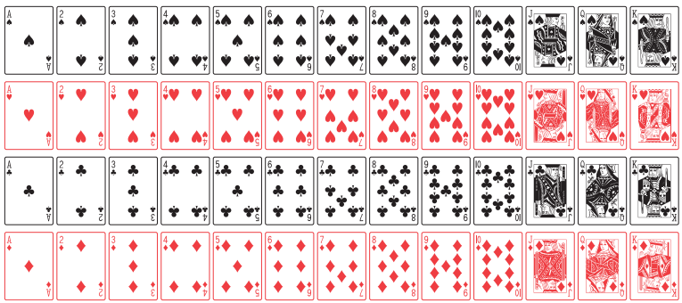
Introduction to Probability
Instructor
Osama Bin Ajaz

Slide 2
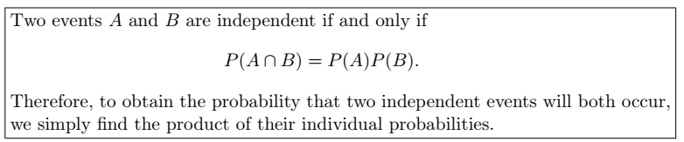
The Product Rule: Independent Events

Slide 3
Some important results for Independent events
(i) A’ and B are independent = P (A’∩ B ) = P(A’).P(B)
(ii) A and B’ are independent = P (A ∩ B’) = P(A).P(B’)
(iii) A’ and B’ are independent = P(A’ ∩ B’) = P(A’).P(B’)
If A and B are independent then they are not mutually exclusive.
If A, B, and C are independent, then P(A ∩B ∩ C)’ = 1 - P(A).P(B).P(C)
If A, B, and C are independent, then P (A U B U C) = 1 – P(A’ ∩ B’ ∩ C’)

Slide 4
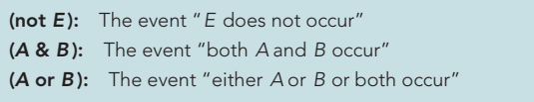
Relationship among events

Slide 5
Examples # 13 – 14
A small town has one fire engine and one ambulance available for emergencies. The probability that the fire engine is available when needed is 0.98, and the probability that the ambulance is available when called is 0.92. In the event of an injury resulting from a burning building, find the probability that both the ambulance and the fire engine will be available, assuming they operate independently.
A bag contains 5 red and 7 black balls. A ball is drawn at random from the bag, the color is noted and the ball is replaced. A second balls is then drawn. Find the probability that the first balls is red and the second is black.
Notes:
P(A&B) =0.9016 (14) P(A&B) = 35/144

Slide 6
Examples 15 – 17
(15). A die is rolled two times. Find the probability of obtaining a 5 on the first thrown and an even number on the second thrown.
(16). The probability that Ahsan will be alive in 30 years is 0.4 and the probability that Bilawal will be alive in 30 years is 0.8. What is the probability that: (a) both will be alive in 30 years
(b) both of them die (c) Ahsan will be alive and B dead.
(17). A town has two fire engines operating independently. The probability that a specific engine is available when needed is
0.96.
(a) What is the probability that neither is available when needed? (b) What is the probability that a fire engine is available when needed?
Notes:
(15) ½ (16) (a) 0.32, (b) 0.08
(17) 0.004, (a) 0.0016 (b)0.9984.

Slide 7
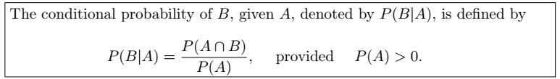
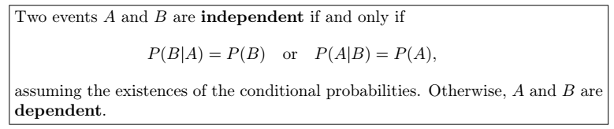
The Product Rule: Dependent Events

Slide 8
Example # 18
(18). Suppose that we have a fuse box containing 20 fuses, of which 5 are defective. If 2 fuses are selected at random and removed from the box in succession without replacing the first, what is the probability that both fuses are defective?
(19). Two cards are drawn in succession from a deck of 52 playing cards without replacement. What is the probability that both cards a are spades.
(20). A box contains 8 tickets bearing the numbers 1, 2, 3, 4, 5, 6, 8, 10. One ticket is drawn and kept aside. Then a second ticket is drawn. What is the probability that both the tickets show even numbers.
Notes:
(18) 1/19. (19). 1/17 (20). 5/14

Slide 9
Example # 21
(21). In a certain college 25% of the students passed Mathematics, 15% of the students passed statistics and 10% of the students passed both mathematics and Statistics. A students is selected at random.
(a) if he passed statistics, what is the probability that he passed mathematics.
(b) if he passed mathematics, what is the probability that he passed statistics.
(22). Suppose a pair of dice is tossed once. If it is known that one die shows a 3. what is the probability that other die shows a 6.
Notes:
(21) a. 0.10/0.15 = 2/3 (b) 2/5 (22) P(B\A) = [2/36]/11/36 = 2/11
P(6|3)=P(6 intersection 3) / P(3) =

Slide 10
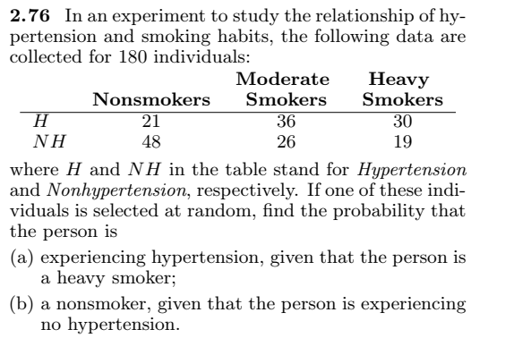
Example # 22
Notes:
P(A\B) = 30/49. P(c\A’)=48/93 total = 180

Slide 11
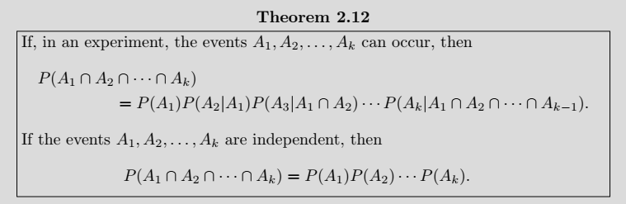
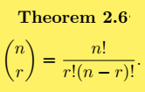

Example # 23
(2.91) Find the probability of randomly selecting 4 good quarts of milk in succession from a cooler containing 20 quarts of which 5 have spoiled, by using
(a) the first formula of Theorem 2.12 on page 68.
(b) the formulas of Theorem 2.6 and Rule 2.3 on pages 50 and 54, respectively.
Notes:
91/323

Slide 12
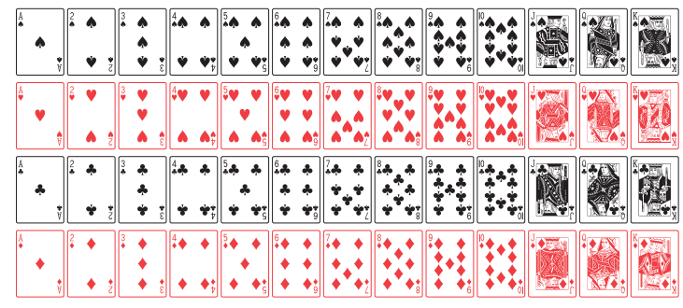

Slide 13
Example # 23
A card is drawn is random from a deck of ordinary playing cards. What is the probability that it is a diamond, a face card or a king?
Solution:
Let A = the card drawn is diamond
B = the card drawn is face card, &
C = the card drawn is a king
P (A U B U C) =
Notes:
P (A U B U C ) = 22/52 = 0.423

Slide 14
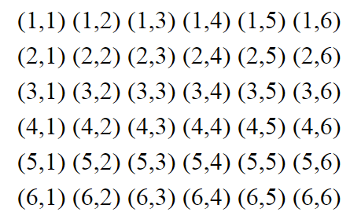
Example # 24
A man tosses two fair dice. What is the conditional probability that the sum of two dice will be 7, given that
(i) the sum is odd. (B)
(ii) the sum is greater than 6. (C)
(iii) the two dice had the same outcome. (D)
Solution:
Notes:
A=sum of two dice is 7
P(A|B) = (6/36)*(36/18) = 1/3 P(A|C) = (6/36)*(36/21) P(A|D) = 0 * (36/6) = 0

Slide 15
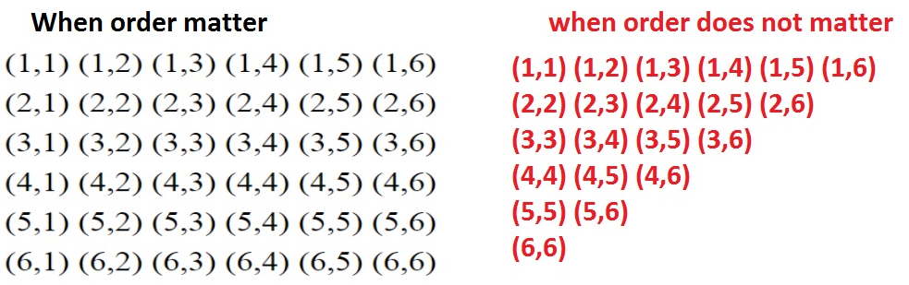

Slide 16
Example # 25
Two coins are tossed. What is the conditional probability that two heads results, given that there is at least one head?
Notes:
P(A∩B) = ¼ = {HH} P(B) = ¾ P(A|B) = 1/3

Slide 17
Example # 25
Two events A & B are such that P(A) = 1/4, P(A|B)=1/2, P(B|A) = 2/3
Are A and B independent events?
Are A and B mutually exclusive events?
Find P(A∩B)
Solution:
Notes:
(iii) P(A∩B)=P(A).P(B|A) = (1/4)*((2/3) = 1/6

Slide 18
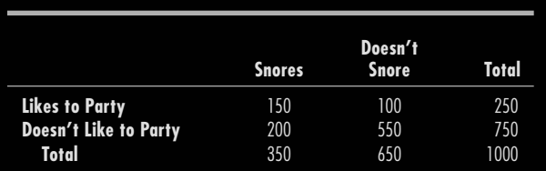



Example: Roommate Compatibility
Baber is off to college. There are 1000 additional new male students, and one of them will be randomly assigned to share Baber’s dorm room. He is hoping that it won’t be someone who likes to party or who snores. The table for the 1000 students is given below. What is the probability that Baber will be disappointed and get a roommate who either likes to party or snores or both?
Notes:
P(Baber will be disappointed) = 0.45
P(Baber get a roommate who is acceptable) = 1 - 0.45 = 0.55

Slide 19
Example # 26
In a certain assembly plant, three machines, B1, B2, and B3, make 30%, 45%, and 25%, respectively, of the products. It is known from past experience that 2%, 3%, and 2% of the products made by each machine, respectively, are defective. Now, suppose that a finished product is randomly selected. What is the probability that it is defective?
Solution:
A: the product is defective, B1: the product is made by machine B1, B2: the product is made by machine B2, B3: the product is made by machine B3,
Notes:
P(D1|B1) + P(D2|B2) + P(D3|B3) = (0.3)*(0.02) + (0.45)*(0.03) + (0.25)*(0.02) = 0.0245.

Slide 20
Tree Diagram for Example # 26
P(A|B1) = 0.02
P(B1) = 0.3
P(A|B2) = 0.03
P(B2) = 0.45
P(B3) = 0.25
P(A|B3) = 0.02

Slide 21
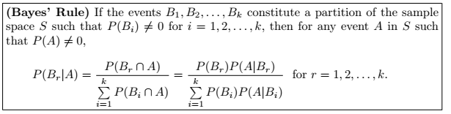
Baye’s Rule

Slide 22

Example # 27
In a certain assembly plant, three machines, B1, B2, and B3, make 30%, 45%, and 25%, respectively, of the products. It is known from past experience that 2%, 3%, and 2% of the products made by each machine, respectively, are defective. Now, suppose that a finished product is randomly selected. What is the probability that it is defective? if a product was chosen randomly and found to be defective, what is the probability that it was made by machine B3?
Solution:
Notes:
P(B3|A) = 0.005/(0.006)+(0.0135)+(0.005) = 0.005/0.0245 = 10/49

Slide 23
Example # 28
Suppose a Software House based in Karachi required the post of Programmer. After interviewing many applicants, the firm has identified 20 applicants categorized as in the following contingency table:
If a diploma holder is selected, what is the probability that the person is a Male.
 | Certificate | Diploma | Total
Male | 10 | 2 | 12
Female | 5 | 3 | 8
Total | 15 | 5 | 20
Notes:
P(D) = P(D∩M) + P(D∩F) = 0.10 + 0.15 = 0.25 P(M∩B) = 0.10 P(M|D) = 0.10/0.25 = 0.4

Slide 24
Example # 29
Suppose 25 colored balls are distributed in three bags, which are identical in appearance as follows:
A bag is selected as random from which a ball is drawn at random.
Find the probability that the ball is yellow.
Given that ball is yellow, what is the probability that bag 2 was selected.
 | BAG
 | 1 | 2 | 3 | Total
Green | 1 | 3 | 4 | 8
Yellow | 2 | 2 | 3 | 7
Red | 4 | 5 | 1 | 10
Total | 7 | 10 | 8 | 25
Notes:
(B) PB2|Y) = ( 0.23

Slide 25
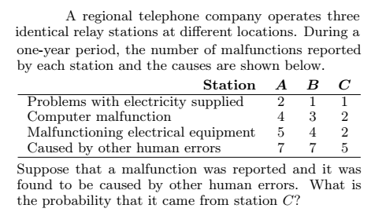
Notes:
0.2632 = P(C|E)
Grant total = 43, HumanErrorTotal = 19

Slide 26
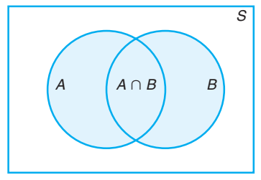
Prove rules of Multiplication for probability
Suppose A & B represent two events, then
P(A∩B) = P(A).P(B|A) 🡪 dependent events
P(A∩B) = P(A).P(B) 🡪 independent events
Proof:

Slide 27
Prove that P(A|B) = P(A) for independent events

Slide 28
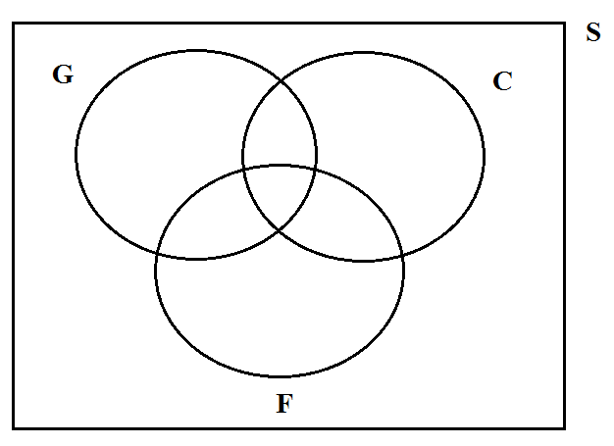
Miscellaneous Problems
Q1) In a survey on 136 boys, 67 played golf, 56 played cricket and 40 played football 11 played both golf and cricket, 12 played both cricket and football and 9 played both golf and football. Each boy played at least one of these games. How many played all the three games. (use Venn diagram)
n(S) = 136
n(G) = 67
n(C) = 56
n(F) = 40
n(G & C) = 11
n(C & F) = 12
n(G & F) = 9
n(G & F & C) = x = ?
47+x
11-x
33+x
x
9-x
12-x
19+x
Notes:
X = 5 played all three games.

Slide 29
Miscellaneous Problems (Contd.)
Q2) A newsagent sells three papers, the Jang, the Dawn, and the BR, 70 customers buy the Jang, 60 the Dawn, and 50 the BR, 17 buy both the Jang & Dawn, 15 the Dawn & the BR, and 16 the BR & the Jang, while 3 customers buy all three papers. How many customers has he?
Q3) A total of 365 Capsules, each marked by the difference dates of the year, are mixed and one capsule is picked at random. What is the probability that the capsule picked will be of:
A day of January
March 2
Either of March or April
Not of December
Notes:
(2)Total customers = 135 (Q3) (i) 31/365, (ii) 1/365 (iii) 61/365 (iv) 334/365

Slide 30
Miscellaneous Problems (Contd.)
Q4) How many three-digit numbers can be formed from the digits 0, 1, 2, 3, 4, 5, and 6 if each digit can be used only once?
(b) How many of these are odd numbers? (c) How many are greater than 330?
Q5) How many number each of 5 different digits can be formed from the digits 0, 4, 5, 6, & 7, if
(a) the digits 4 and 5 are to be next to each other,
(b) the digits 4 and 5 are not to be next to each other
Notes:
Q4) 180, 75, 105 (Q5) (a) 36, (b) total ways = 96, 96-36=60

Slide 31
Miscellaneous Problems (Contd.)
Q6) How many permutations can be obtained from the letters in ARTICLE, if
(a) Consonants occupy the odd places
(b) R and T occupy the ends
(c) T and C come together
Notes:
Q6) 144, 240, 1440

Slide 32
Miscellaneous Problems (Contd.)
Q7) Find the number of four letter words that can be formed from the letters for the word SOCIETY.
(a) how many of them contain only consonants.
(b) how many of them begin and end in a consonant.
(c) how many of them begin with a vowel.
(d) how many contain the letter E.
(e) how many begin with Y and end in a vowel.
(f) how many begin with Y and also contain T.
(g) how many contain one vowel.
Notes:
840 (a) 24 (b)240 (c) 360 (d) 480 (e) 60 (f)60 (g) 288

Slide 33
Miscellaneous Problems (Contd.)
Q8) The probabilities that three men hit a target are respectively 1/6, 1/4 and 1/3. Each shoots once at the target. If only one hit the target, what is the probability that it was the first man.
Notes:
P(M1 \ One Hit) = 6/31=0.1935

Slide 34
Miscellaneous Problems (Contd.)
Q9) A box contains 24 transistors, four of which are defective. If four are sold at random, find the following probabilities.
(a) Exactly two are defective
(b) all are defective
(c) none is defective
(d) at least one is defective
Notes:
(a) P(X=2) = [4c2 * 20c2/24c4]=1140/10626 (b) 1615/3542 (c) 1/24c4=(1/10626) (d) P(at least 1 d)=1 – P(no defective) = 1927/3542

Slide 35
Miscellaneous Problems (Contd.)
Q10) There are eight married couples in a tennis club. If one man and one woman are selected at random to plan the summer tournament, find the probability that they are married to each other.
Notes:
8.8=64 ways to select men and women, 8/64=1/8

Slide 36
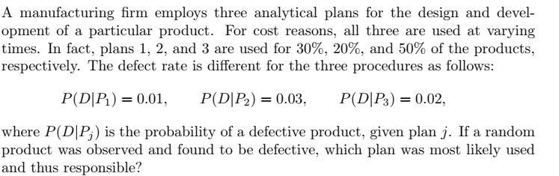
Miscellaneous Problems (Contd.)
Q11)
Notes:
P(P1|D)=0.158; P(P2/D)=0.316 P(P3/D)=0.526 since P(P3/D) is largest of the three, thus a defective is most likely the result of the use of plan 3

